Slide 1
Storyboard of Dashboard
This storyboard is a rough illustration of a webpage that provides a dashboard to the Team TBD Final Project. Each slide depicts the scrolling function on a webpage.
Team TBD

Slide 2
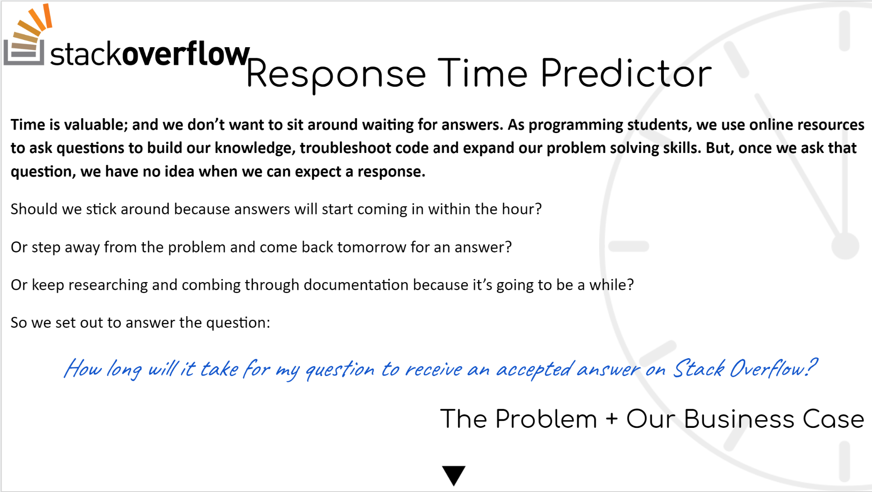
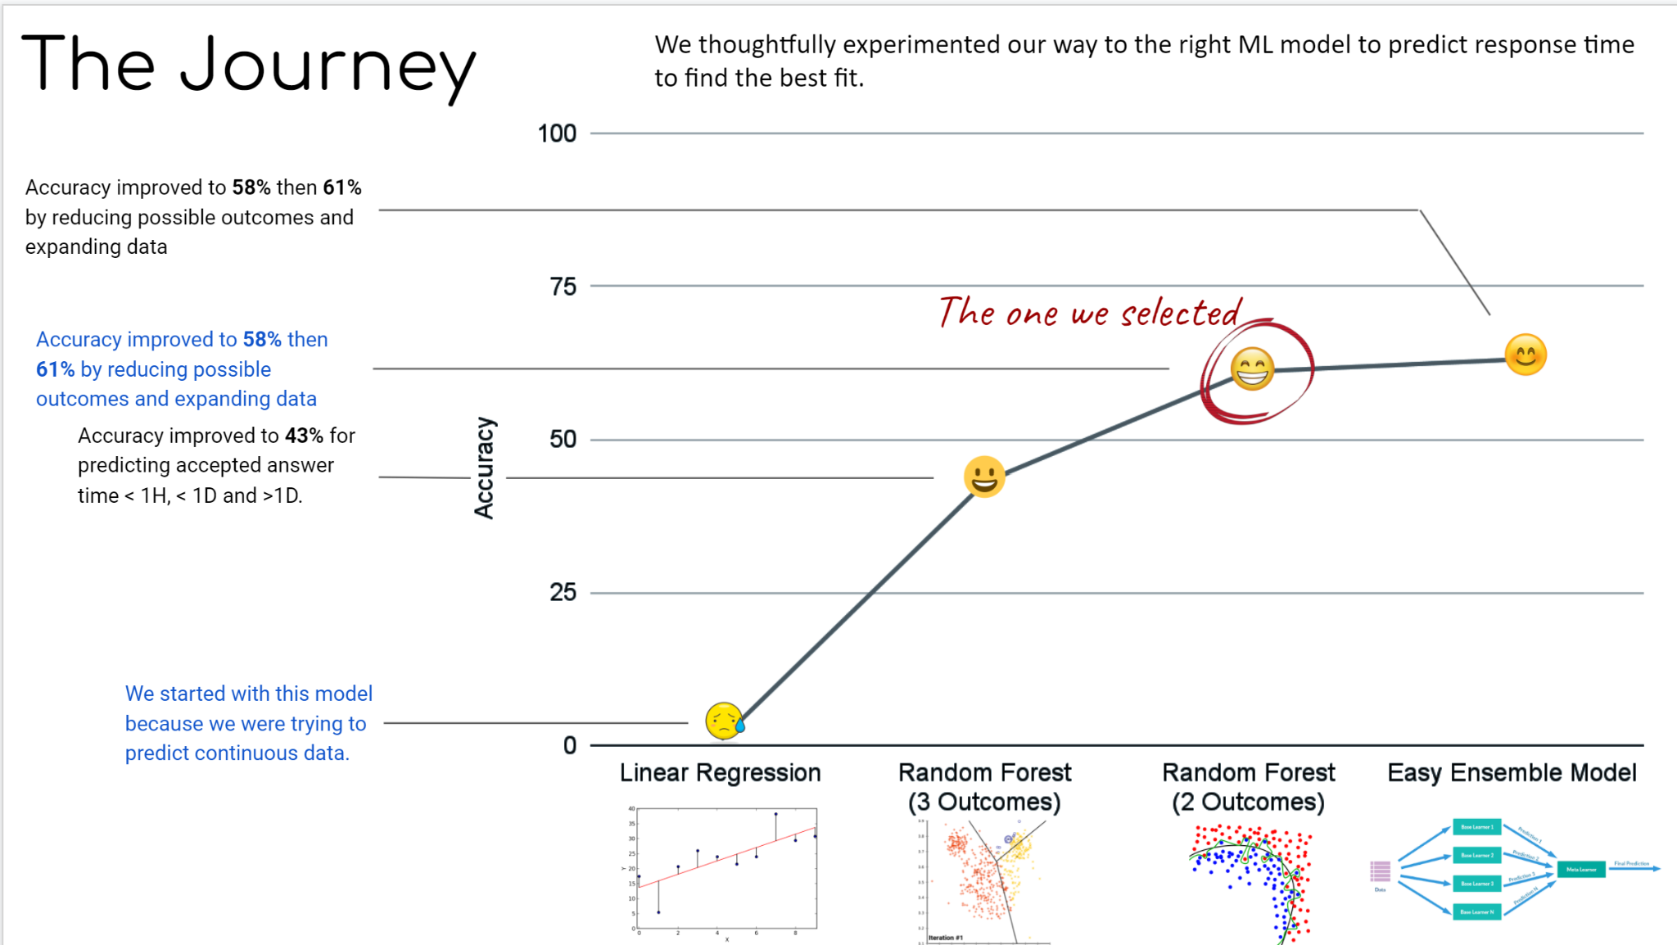
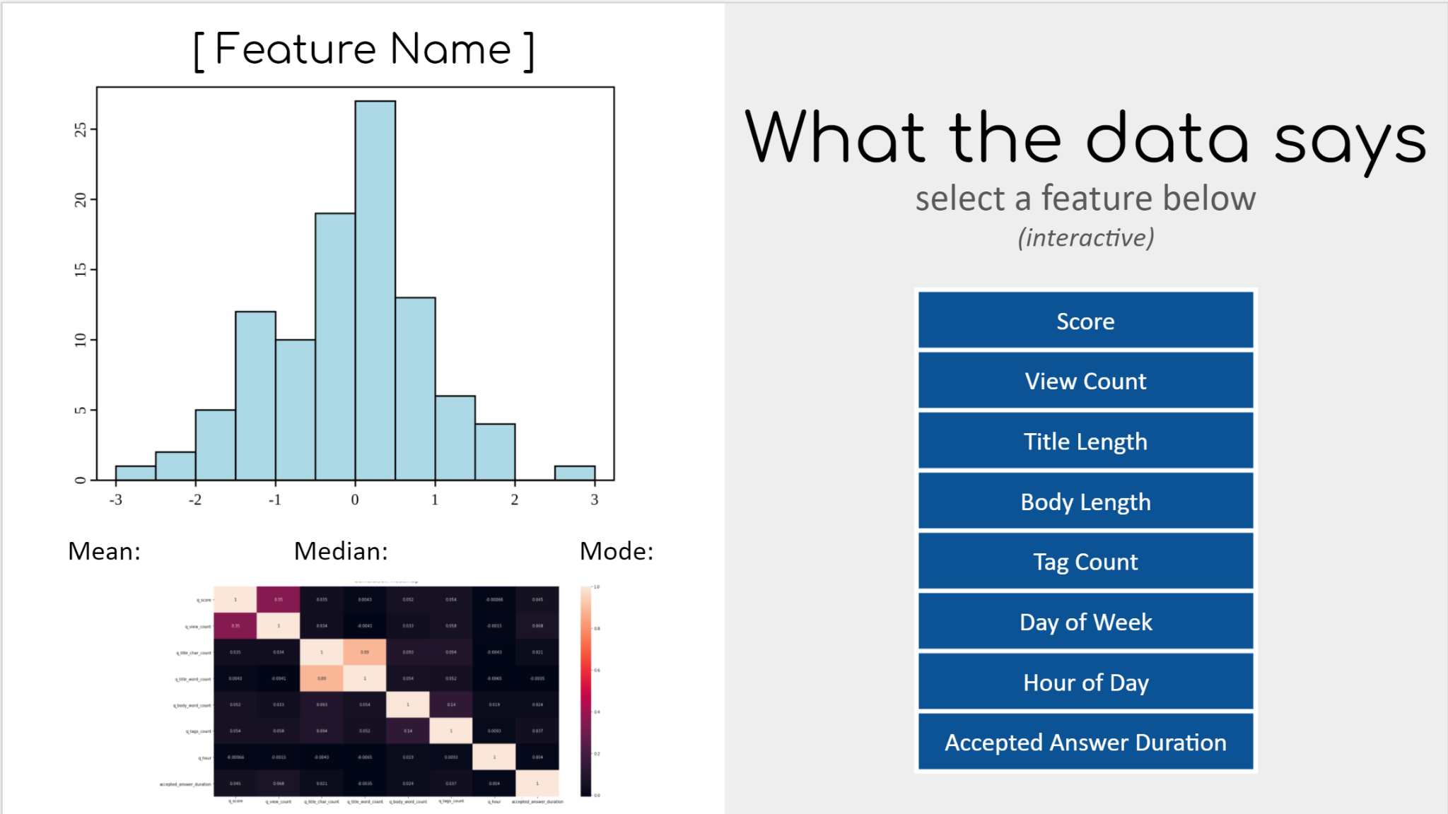
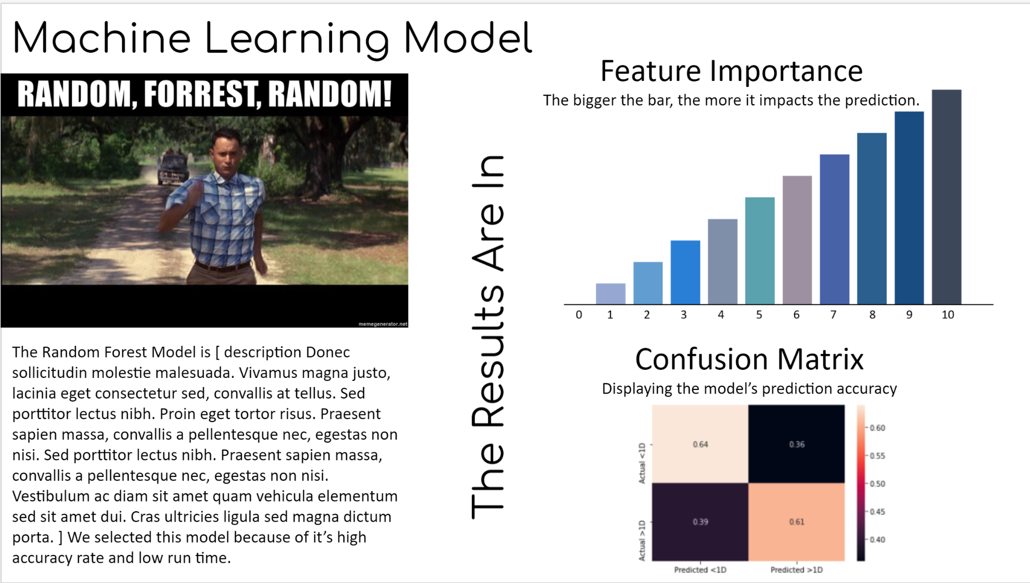
Notes:
Click to expand, or scroll

Slide 3



Response Time Predictor
How long will it take for my question to receive an accepted answer on Stack Overflow?
The Problem + Our Business Case
Time is valuable; and we don’t want to sit around waiting for answers. As programming students, we use online resources to ask questions to build our knowledge, troubleshoot code and expand our problem solving skills. But, once we ask that question, we have no idea when we can expect a response.
Should we stick around because answers will start coming in within the hour?
Or step away from the problem and come back tomorrow for an answer?
Or keep researching and combing through documentation because it’s going to be a while?
So we set out to answer the question:

Slide 4
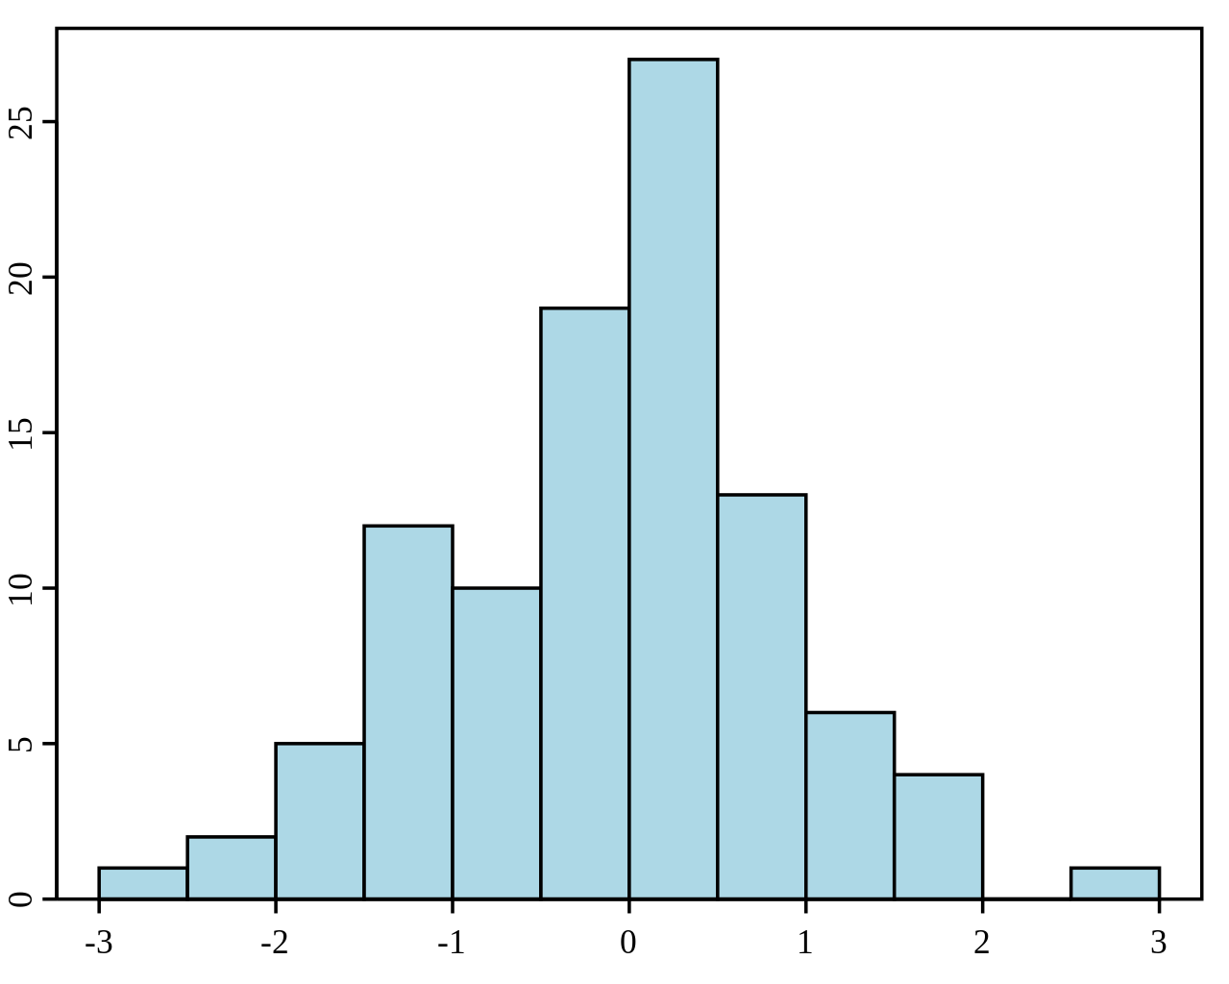
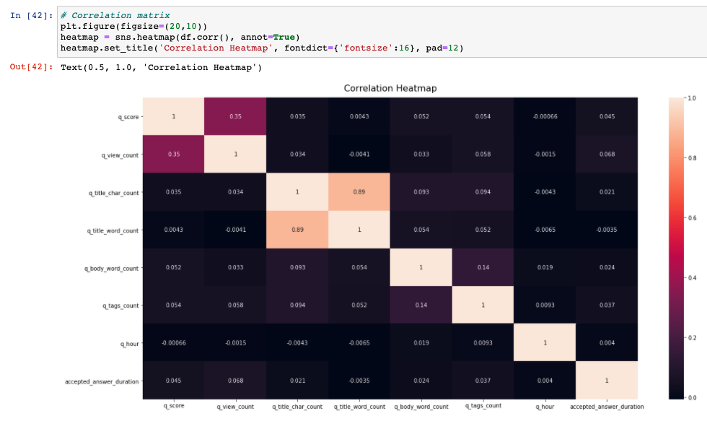
What the data says
[ Feature Name ]
select a feature below
(interactive)
Score
View Count
Title Length
Body Length
Tag Count
Day of Week
Hour of Day
Accepted Answer Duration
Mean: Median: Mode:
Notes:
Add placeholder images
Should look like our final dashboard
Can make multiple pages (click interactive)

Slide 5
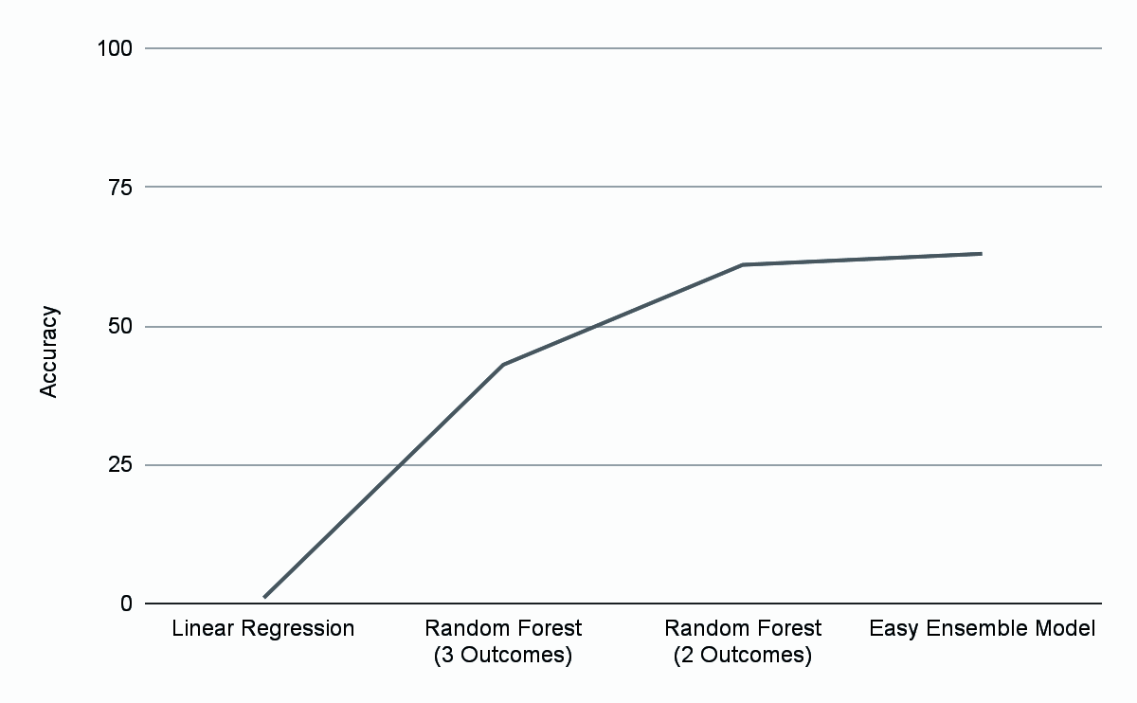





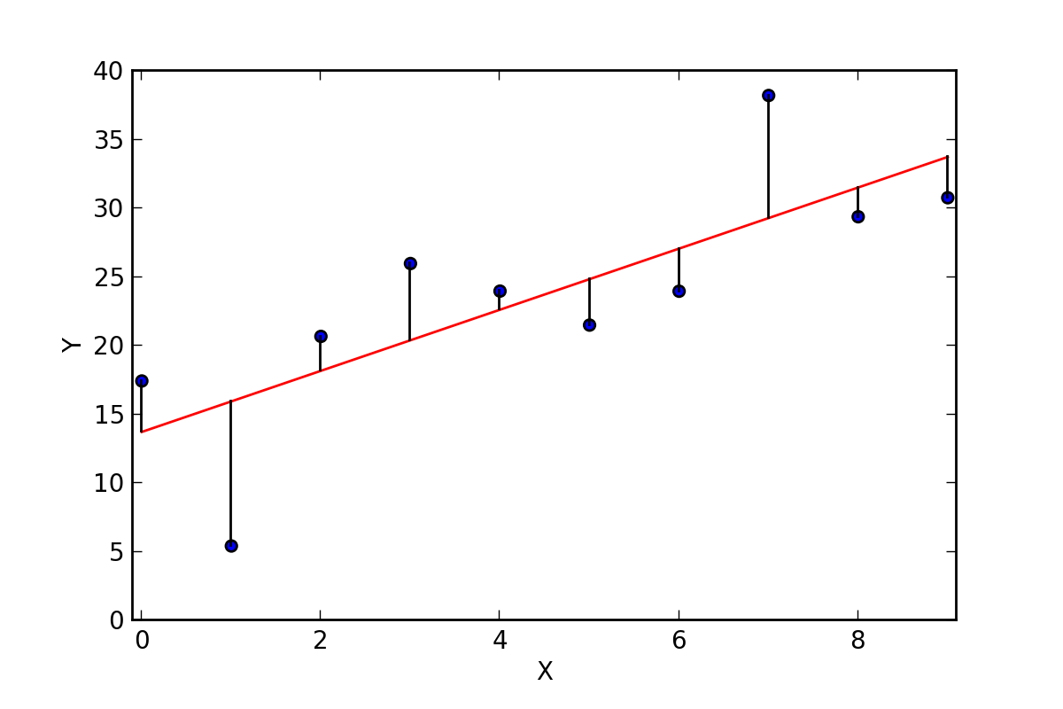
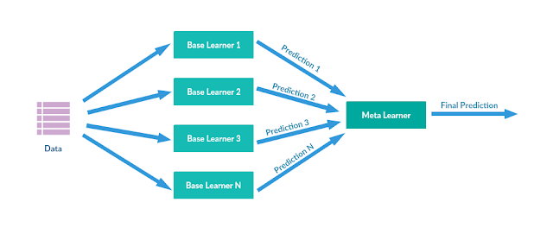

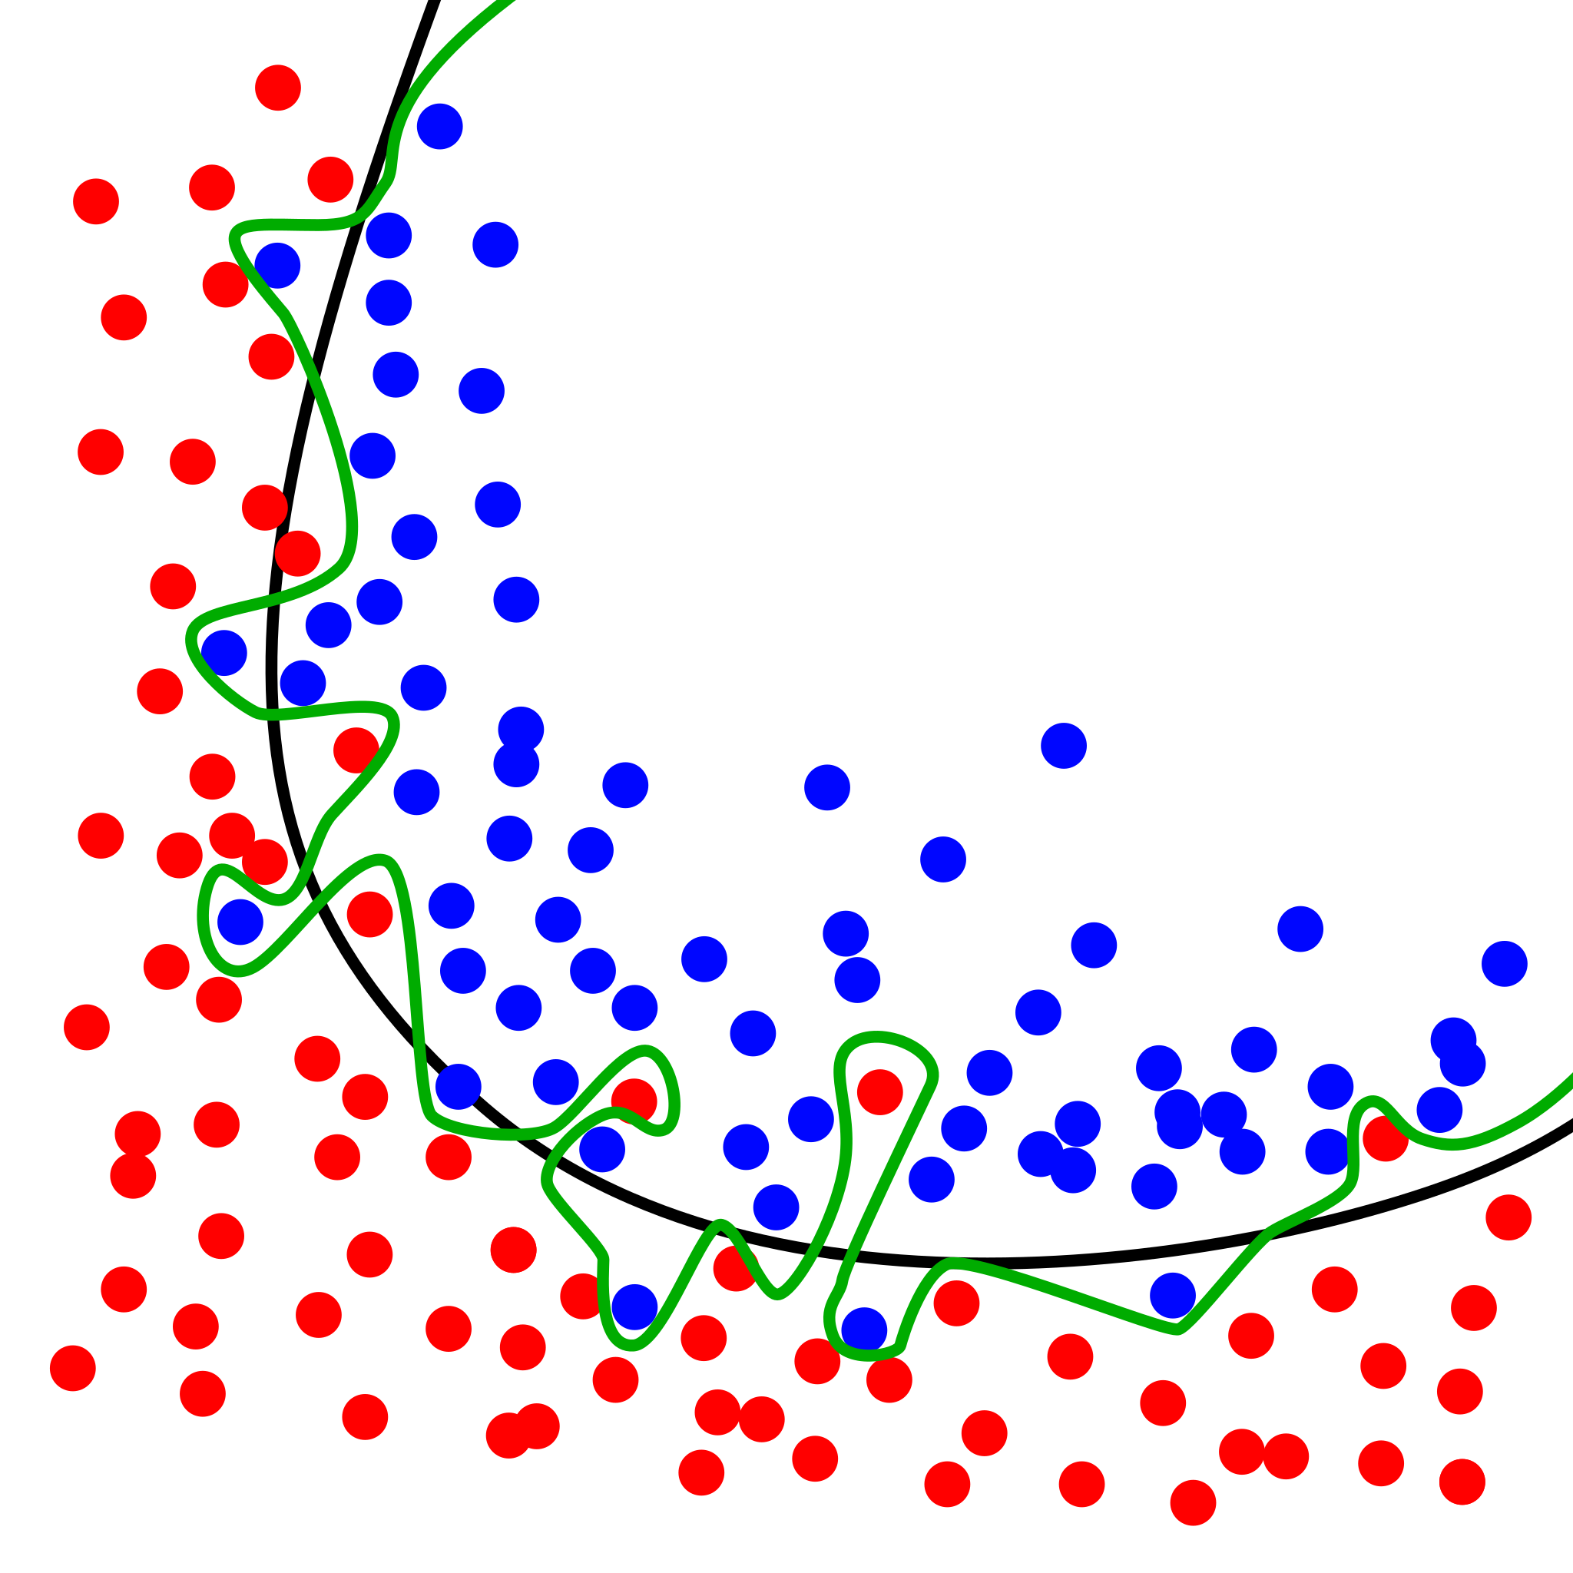
The Journey
We thoughtfully experimented our way to the right ML model to predict response time to find the best fit.
Accuracy improved to 58% then 61% by reducing possible outcomes and expanding data
The one we selected
Accuracy improved to 58% then 61% by reducing possible outcomes and expanding data
Accuracy improved to 43% for predicting accepted answer time < 1H, < 1D and >1D.
We started with this model because we were trying to predict continuous data.

Slide 6
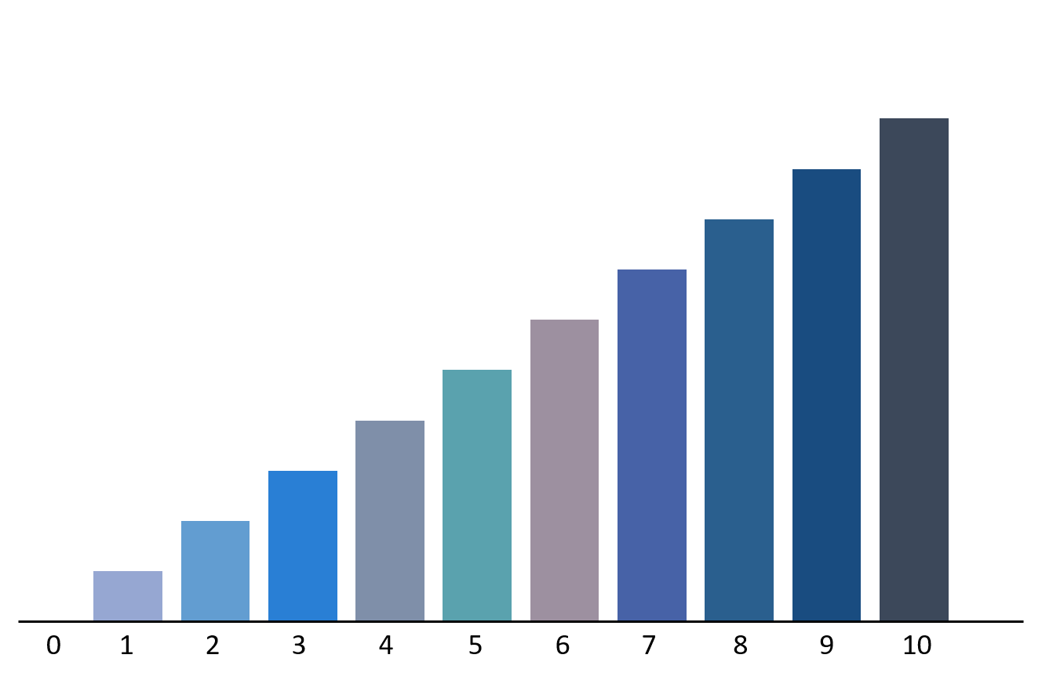

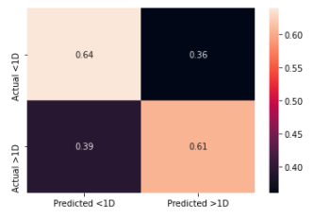
The Results Are In
Machine Learning Model
Feature Importance
The bigger the bar, the more it impacts the prediction.
The Random Forest Model is [ description Donec sollicitudin molestie malesuada. Vivamus magna justo, lacinia eget consectetur sed, convallis at tellus. Sed porttitor lectus nibh. Proin eget tortor risus. Praesent sapien massa, convallis a pellentesque nec, egestas non nisi. Sed porttitor lectus nibh. Praesent sapien massa, convallis a pellentesque nec, egestas non nisi. Vestibulum ac diam sit amet quam vehicula elementum sed sit amet dui. Cras ultricies ligula sed magna dictum porta. ] We selected this model because of it’s high accuracy rate and low run time.
Confusion Matrix
Displaying the model’s prediction accuracy

Slide 7




Project Summary
What is
Stack Overflow
Tools Used
Curabitur arcu erat, accumsan id imperdiet et, porttitor at sem. Nulla porttitor accumsan tincidunt. Praesent sapien massa, convallis a pellentesque nec, egestas non nisi. Cras ultricies ligula sed magna dictum porta. Curabitur non nulla sit amet nisl tempus convallis quis ac lectus. Donec sollicitudin molestie malesuada. Proin eget tortor risus. Nulla porttitor accumsan tincidunt. Donec rutrum congue leo eget malesuada. Vestibulum ac diam sit amet quam vehicula elementum sed sit amet dui.
Curabitur arcu erat, accumsan id imperdiet et, porttitor at sem. Nulla porttitor accumsan tincidunt. Praesent sapien massa, convallis a pellentesque nec, egestas non nisi. Cras ultricies ligula sed magna dictum porta. Curabitur non nulla sit amet nisl tempus convallis quis ac lectus. Donec sollicitudin molestie malesuada. Proin eget tortor risus. Nulla porttitor accumsan tincidunt. Donec rutrum congue leo eget malesuada. Vestibulum ac diam sit amet quam vehicula elementum sed sit amet dui.
Curabitur arcu erat, accumsan id imperdiet et, porttitor at sem. Nulla porttitor accumsan tincidunt. Praesent sapien massa, convallis a pellentesque nec, egestas non nisi. Cras ultricies ligula sed magna dictum porta. Curabitur non nulla sit amet nisl tempus convallis quis ac lectus. Donec sollicitudin molestie malesuada. Proin eget tortor risus.

Slide 8
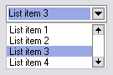
The Data
[ Feature Name ]
what we saw in the numbers
(interactive)
Mean: Median: Mode:
Notes:
Add placeholder images
Should look like our final dashboard
Can make multiple pages (click interactive)

Slide 9




The Journey
We thoughtfully experimented our way to the right ML model to predict response time to find the best fit.
Accuracy improved to 58% then 61% by reducing possible outcomes and expanding data
After trying a bit of feature engineering, we still didn’t see an increase in accuracy…
So, we tried regression models.
We started with this model because we were trying to predict continuous data.
RANDOM FOREST WITH 3 POSSIBLE OUTCOMES
EASY ENSEMBLE CLASSIFIER
LOW
ACCURACY
LINEAR
REGRESSION
CLASSIFICATION MODELS
RANDOM FOREST WITH 2 CLASSIFICATIONS
But, the Linear regression model had only a 1% accuracy
Accuracy improved to 43% for predicting accepted answer time < 1H, < 1D and >1D.
This model improved our 63%

